Slide 1
Obesity-Related Comorbidities
Diabetes

Slide 2
Learning Objectives
Understand the relationships between obesity and all-cause mortality
Explain how age modified obesity-associated disease risks
Describe the normal physiology of glucose regulation, including the key roles of pancreas, muscle, liver and adipose tissues
Describe the progression of obesity-associated type 2 diabetes including the pathophysiology of these changes
Apply your knowledge of glucose homeostasis to explain how individuals may progress towards type 2 diabetes differently

Slide 3
Obesity and All-Cause Mortality
Similar effects for males
Increased risk at low and high BMI
More risk at younger obesity
Adams KF, Schatzkin A, Harris TB, Kipnis V, Mouw T, Ballard-Barbash R, Hollenbeck A, Leitzmann MF. Overweight, Obesity, and Mortality in a Large Prospective Cohort of Persons 50 to 71 Years Old. N Engl J Med. 2006; 355: 763–78. doi: 10.1056/NEJMoa055643.

Slide 4
Obesity-Related Causes of Death
2002 data
Flegal KM, Graubard BI, Williamson DF, Gail MH. Cause-Specific Excess Deaths Associated With Underweight, Overweight, and Obesity. Jama. 2007; 298: 2028. doi: 10.1001/jama.298.17.2028.

Slide 5
Childhood obesity relative risks
Disease | Adult Obesity | Child Obesity
Cardiovascular Disease
Diabetes

Slide 6
Type 2 Diabetes and Obesity

Slide 7
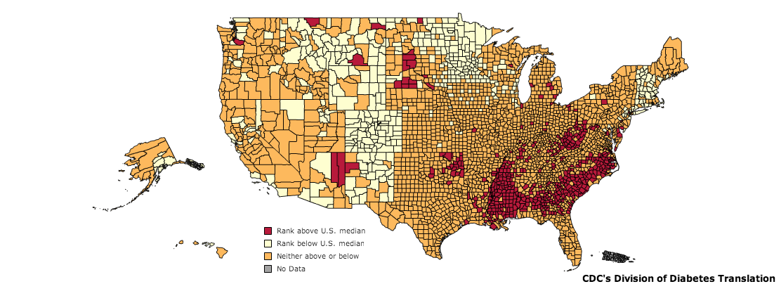
Diabetes in the United States
CDC, 2010
Notes:
As of 2011, diabetes affects 25.8 million people or 8.3% of the population. This includes approximately 7 million undiagnosed individuals. In addition to this, 79 million Americans over the age of 20 are estimated to be pre-diabetic. As of 2007, diabetes is estimated to cost $116 billion in direct and $58 billion in indirect costs [@CDC2011].
Diabetes is especially prevalent in this region. As shown in the map, there is a higher percentage of diabetics in the mid and deep south regions of the United States.

Slide 8
Glucose Regulation

Slide 9


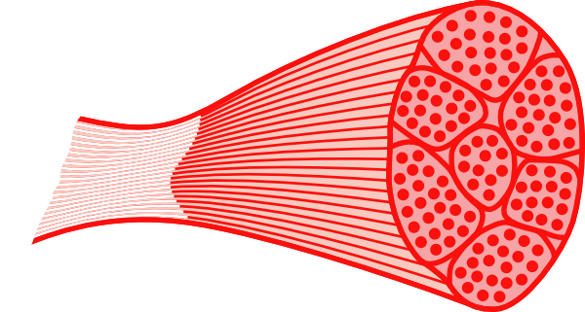
Regulation of Blood Glucose Levels
Gluconeogenesis
Disposal
Glucose Uptake
Glucose Storage
Glucose Utilization
Glucose Production
Glucose Uptake
Glucose Storage
and Utilization
Notes:
Ask for some examples of how glucose is stored, or how it is utilized

Slide 10
Insulin reduces blood glucose
Released by beta cells of the pancreas
Removes glucose from the blood by stimulating uptake in fat and muscle
Promotes fat storage
Stops glucose production (gluconeogenesis) in the liver

Slide 11
Obesity is associated with insulin resistance
Insulin-Stimulated glucose uptake
DeFronzo RA. Lilly lecture 1987. The triumvirate: beta-cell, muscle, liver. A collusion responsible for NIDDM. Diabetes. 1988; 37: 667–87. doi: 10.2337/diab.37.6.667.

Slide 12
Obesity Related Progression of Diabetes

Slide 13
Varied progression
What are some individual physiological factors that could alter the obesity-diabetes relationship?
Could convert glucose to fat less efficiently
How much fat they can store before developing peripheral insulin resistance
Beta cells could keep increasing insulin production for longer

Slide 14
Ethnic Differences in the BMI-Diabetes Relationship
Chiu M, Austin PC, Manuel DG, Shah BR, Tu J V. Deriving ethnic-specific BMI cutoff points for assessing diabetes risk. Diabetes Care. 2011; 34: 1741–8. doi: 10.2337/dc10-2300.

